Slide 1
Lecture 3 overplotting and introduction to multipanel plots
Trevor A. Branch
FISH507H, Fall 2011
School of Aquatic and Fishery Sciences, University of Washington
catalyst.uw.edu/workspace/tbranch/24589

Slide 2
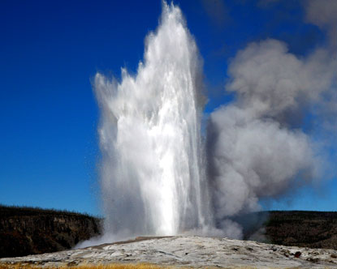
Source: http://www.destination360.com/north-america/us/wyoming/yellowstone-national-park/old-faithful

Slide 3
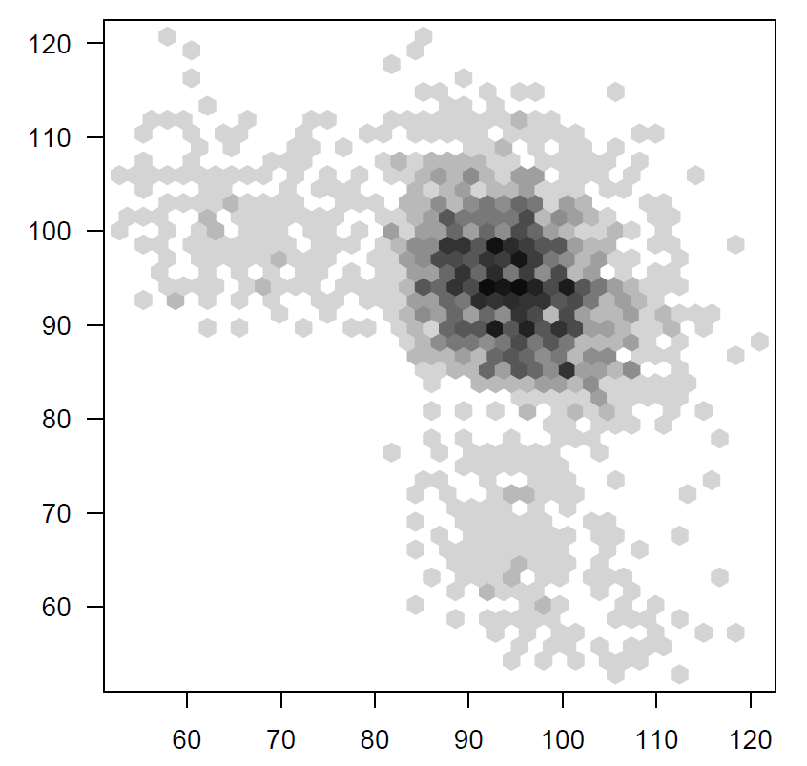
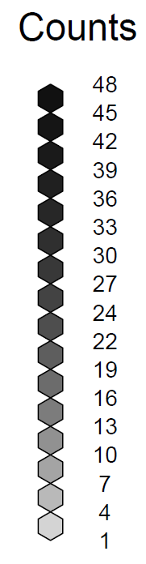
Old Faithful predictions: hexbin
Next interval (min)
This interval (min)

Slide 4
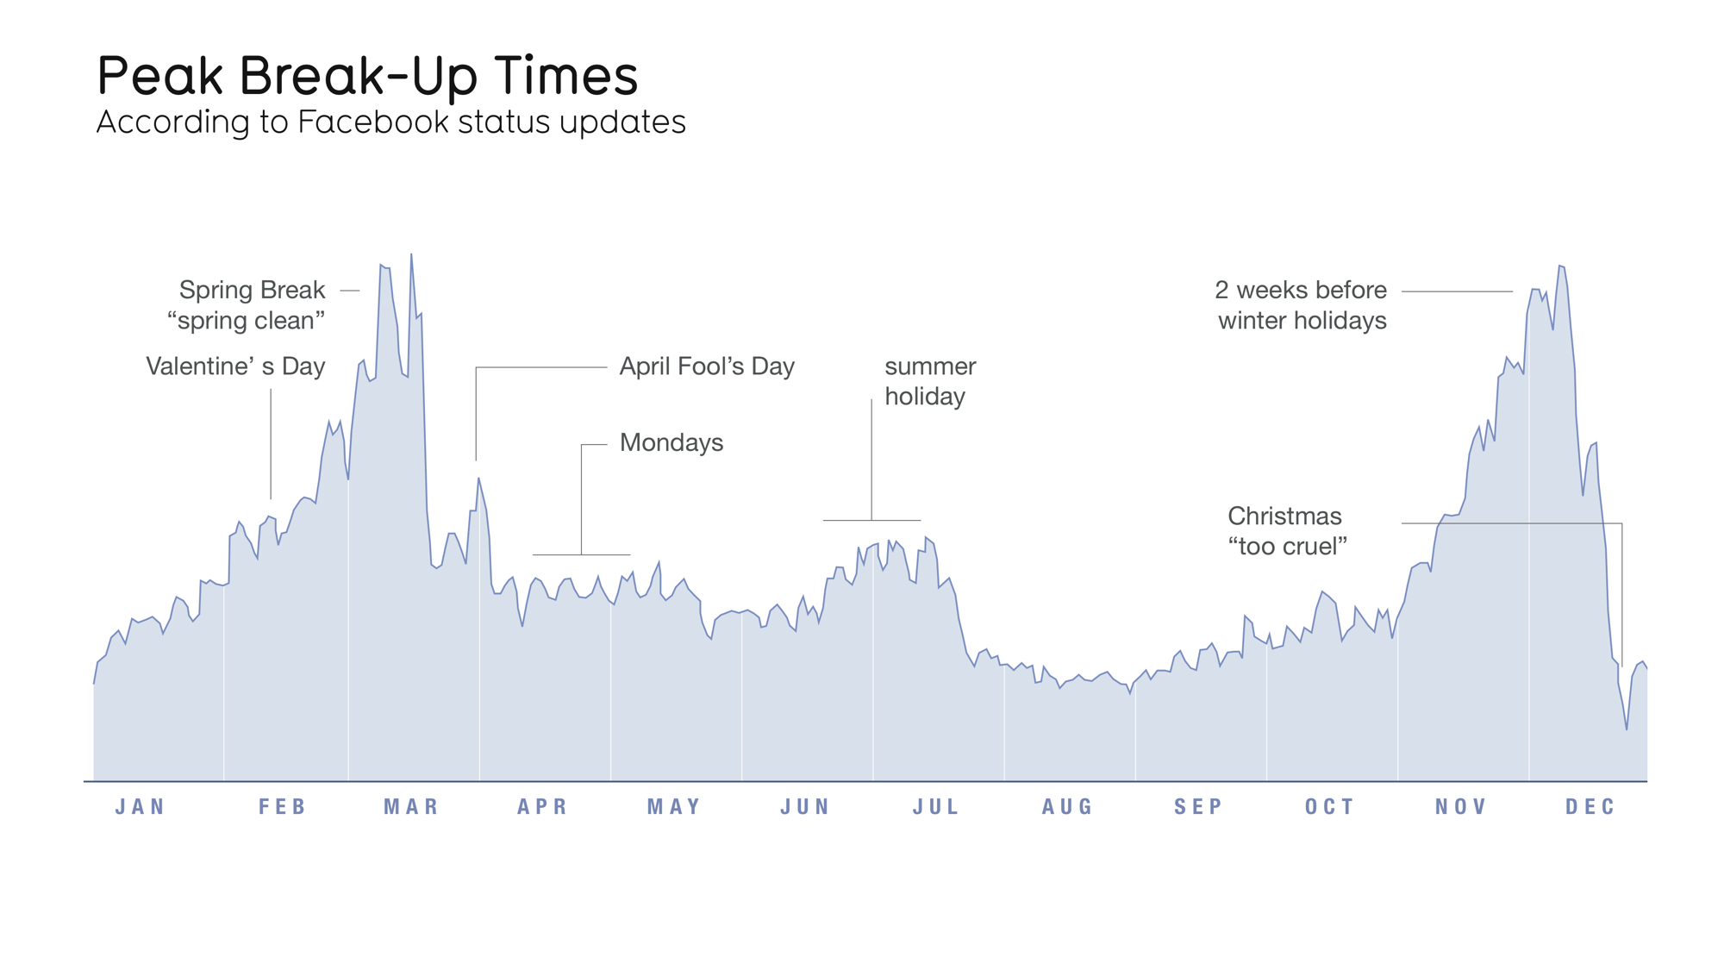
Source: http://www.informationisbeautiful.net/2010/peak-break-up-times-on-facebook/
Created by David McCandless & Lee Byron, taken from The Visual Miscellaneum
Searches for “we broke up because…”

Slide 5
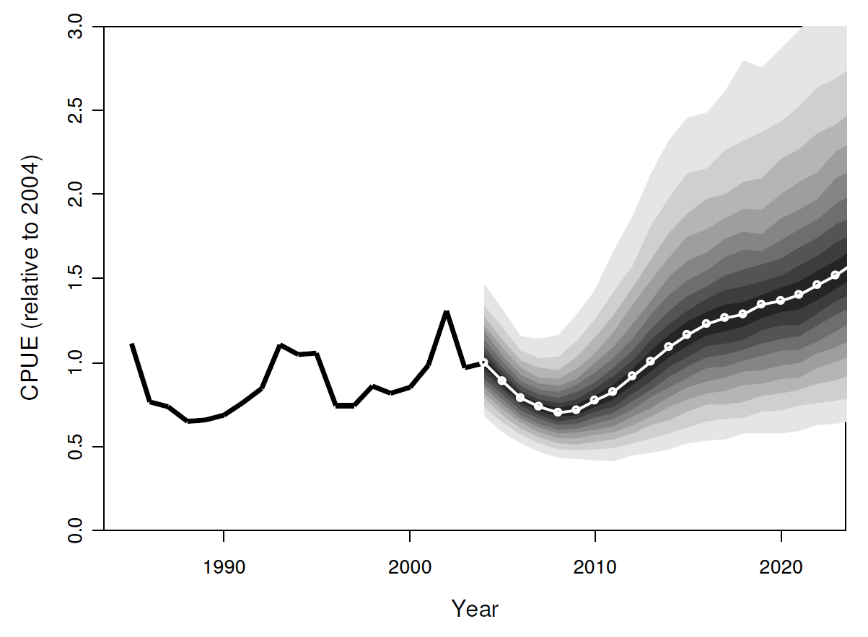
Advanced use of polygon()

Slide 6
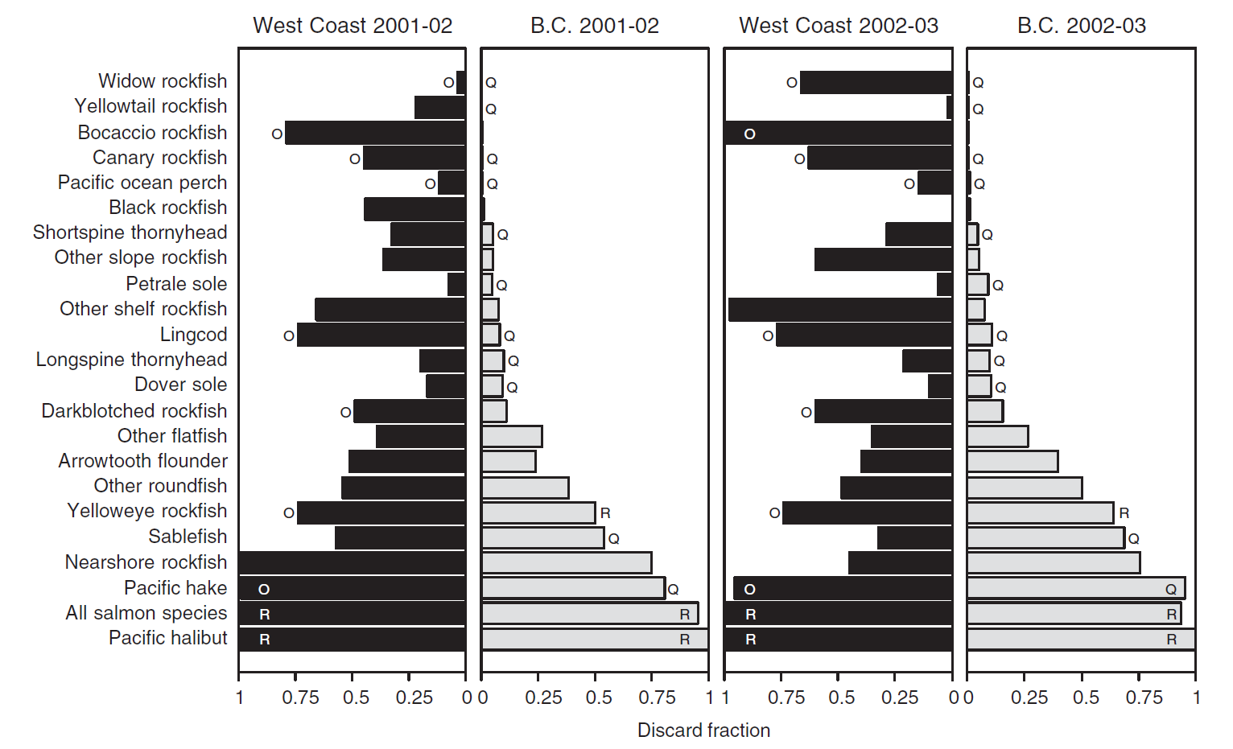
Line shading using col="black" and col="gray50"
Branch et al. (2006) Marine Policy 30:281-296

Slide 7
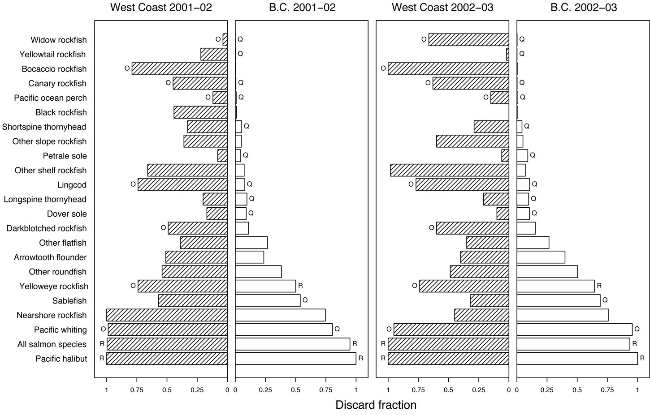
Line shading using angle=45 and number=20
Branch (2006) Bulletin of Marine Science 78:669-690

Slide 8
Multipanel plots: key lessons
Shrink figures
Small multiples
Delete extra axes
One caption per axis

Slide 9
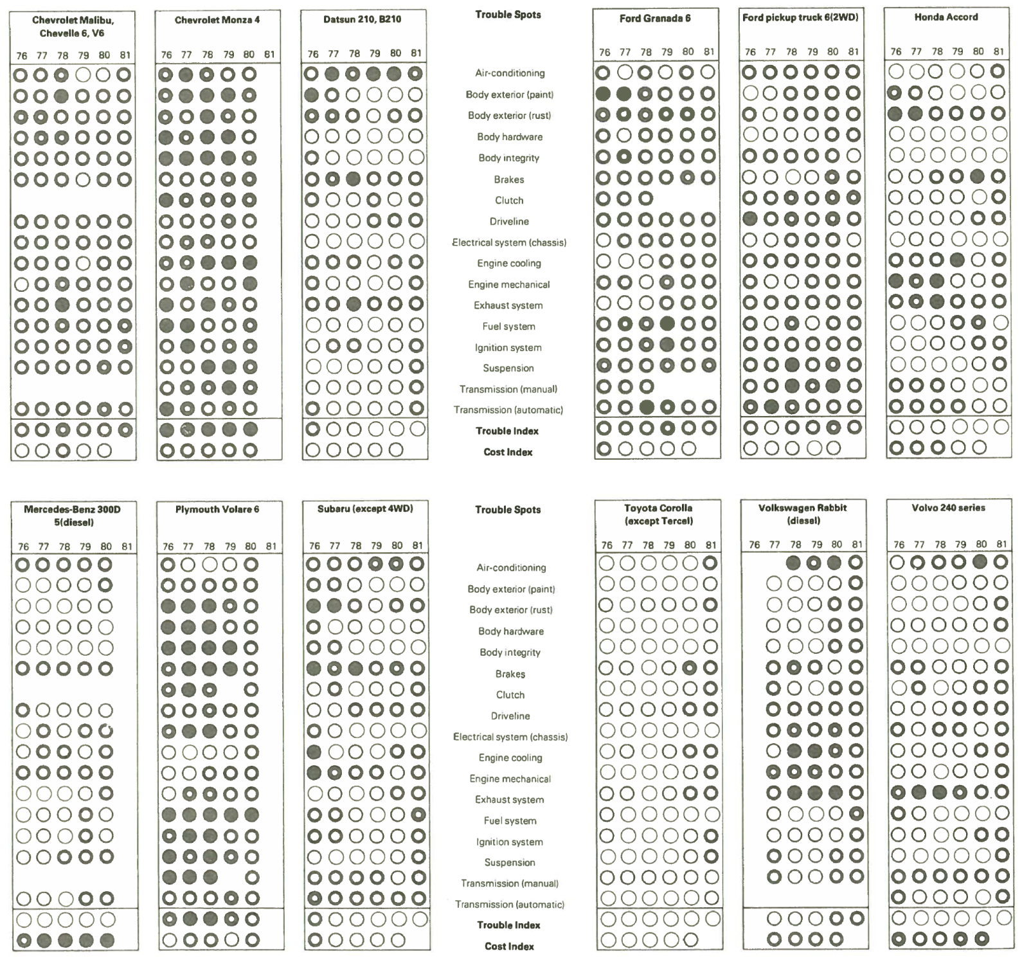
Tufte: small multiples
Consumer Reports 47 (April 1982) p. 199-207
Tufte, ER 2001 The visual display of quantitative information, p. 174

Slide 10
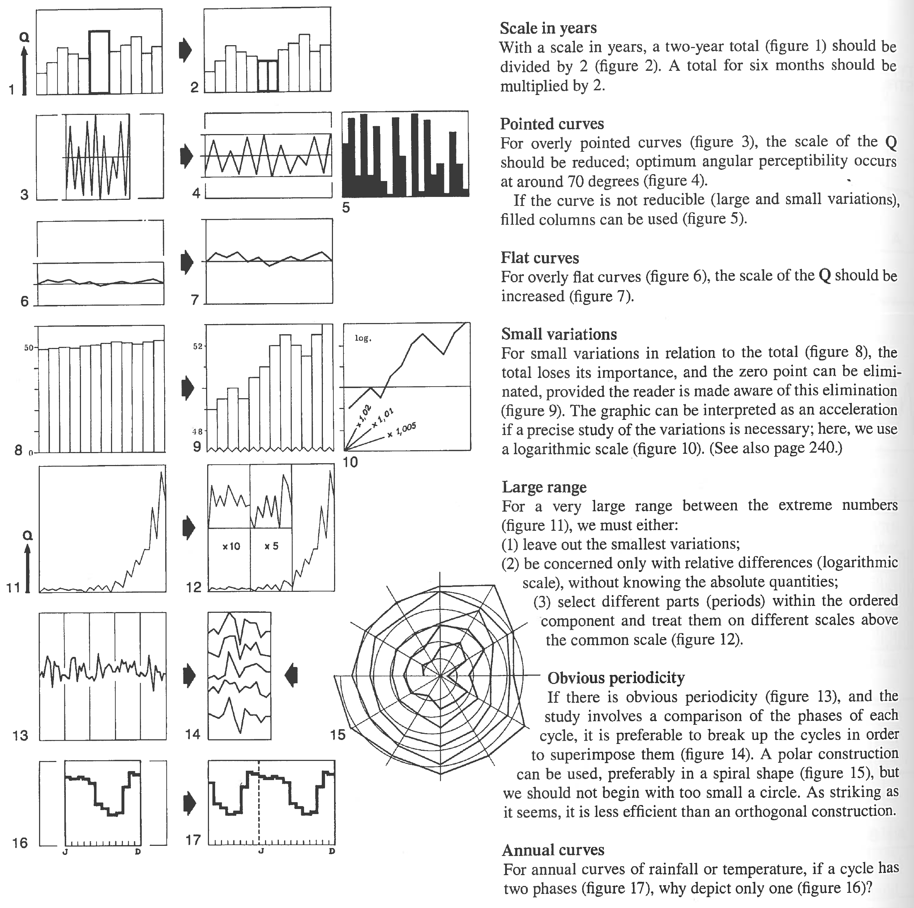
Tufte: graphics can be shrunk way down
Bertin Semiology of Graphics English translation 1983, p. 214
Tufte, ER 2001 The visual display of quantitative information, p. 169

Slide 11
Well-designed small multiples
Comparative
Multivariate
Shrunken, high-density
Large data matrix
Almost entirely data-ink
Efficient in interpretation
Narrative in content

Slide 12
Data density
Data density 0.02 per cm²
Executive Office of the President 1973 Office of Management and Budget, Social Indicators, Washington DC, p. 86
Tufte, ER 2001 The visual display of quantitative information, p. 162-163
Notes:
Data density is 0.02 numbers per square centimeter

Slide 13
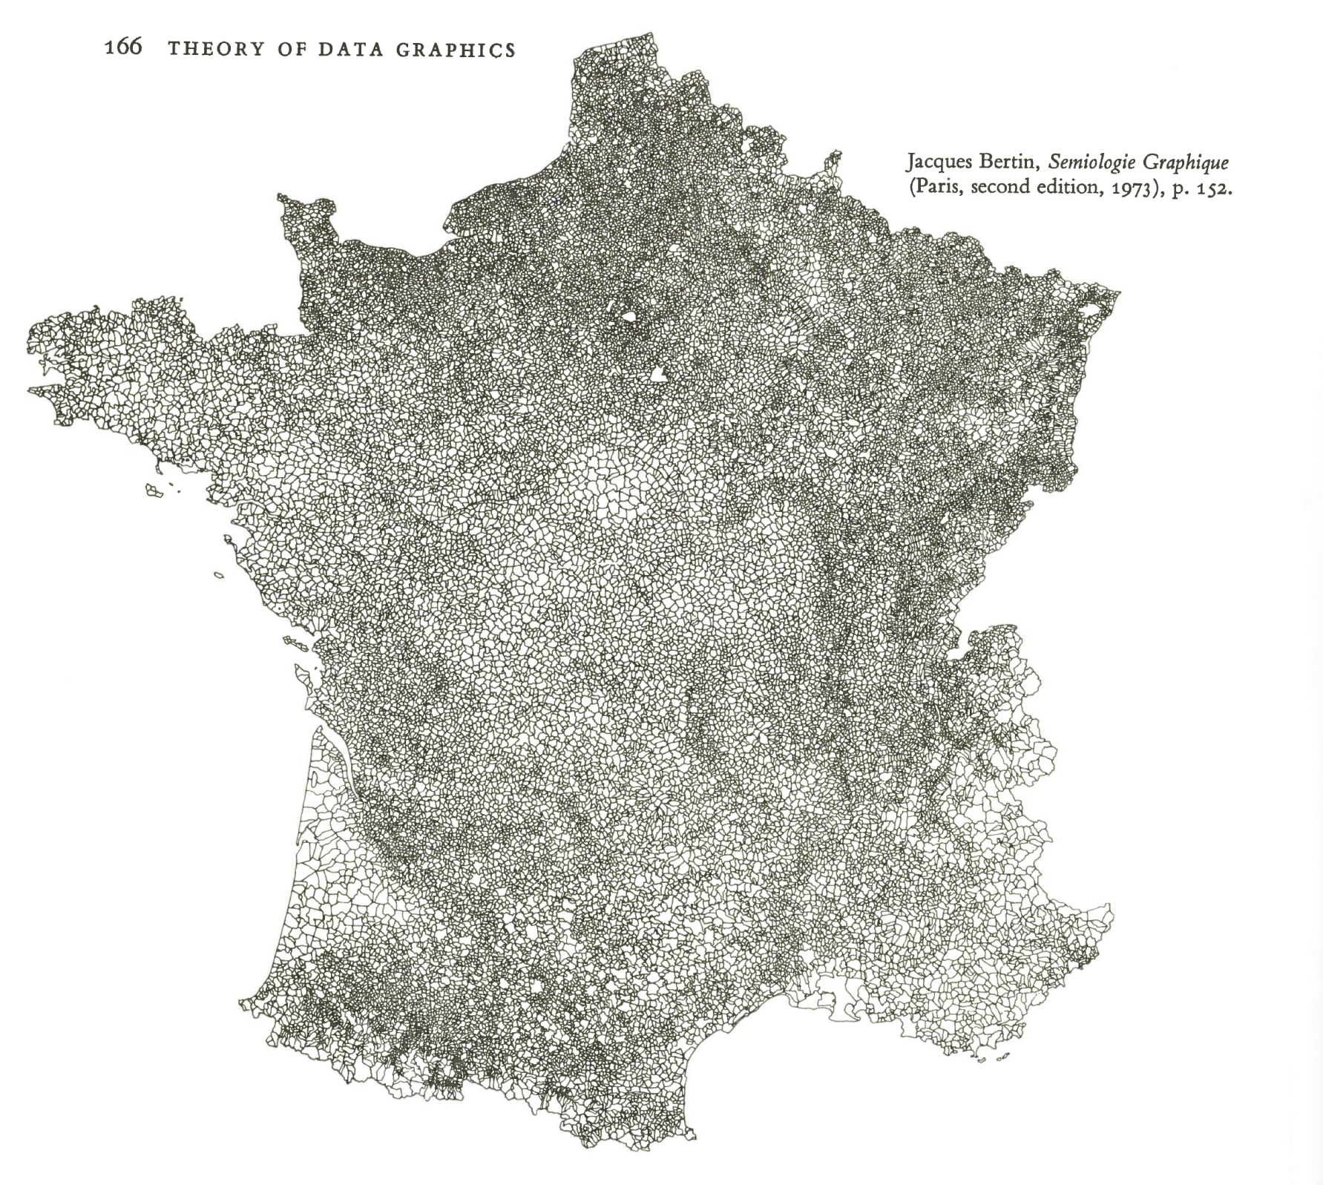
The communes
of France
Data density
17,000 per cm²
Bertin Semiology of Graphics English translation 1983, p. 152
In: Tufte, ER 2001 The visual display of quantitative information, p. 166

Slide 14
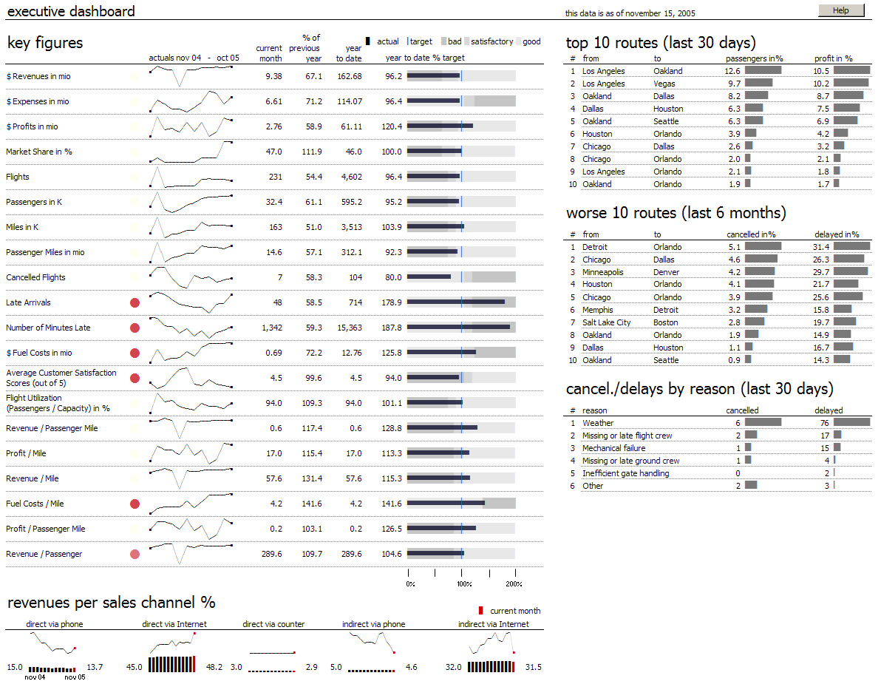
Very high data density

Slide 15
For non-data-ink, less is more.
For data-ink, less is a bore.
Tufte, ER 2001 The visual display of quantitative information, p. 175

